Slide 4
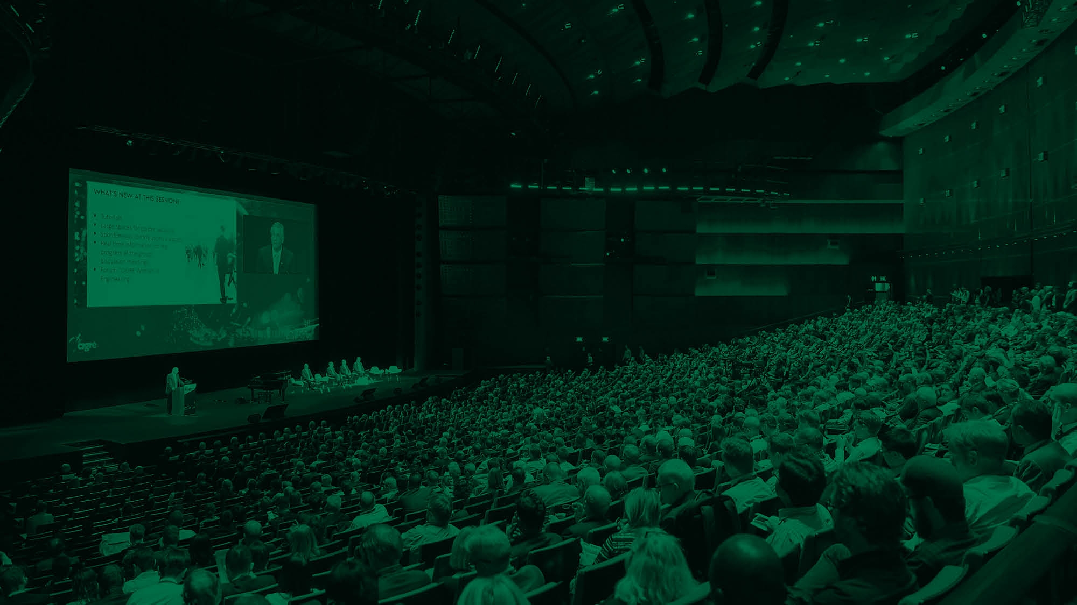

Introducing CIGRE global

Slide 5



Welcome to the world of CIGRE
A global community for the collaborative development and sharing of power
system expertise
Not for profit, established in Paris, France 1921
A long history as a key player in the development of the power system
Produces reference publications based on practical experience and analysed data
An open, engaging, fact-based culture
Connecting power systems professionals from all over the globe
Watch the
welcome video

Slide 6

A collaborative global community sharing
knowledge and expertise
59 National Committees – NCs
15000 members from over 90 countries
1200+ organisations spanning the global power system
A high number of major utilities
A unique collaborative culture
Includes some of the world’s leading experts
Diverse perspectives from every corner of the globe

Slide 7

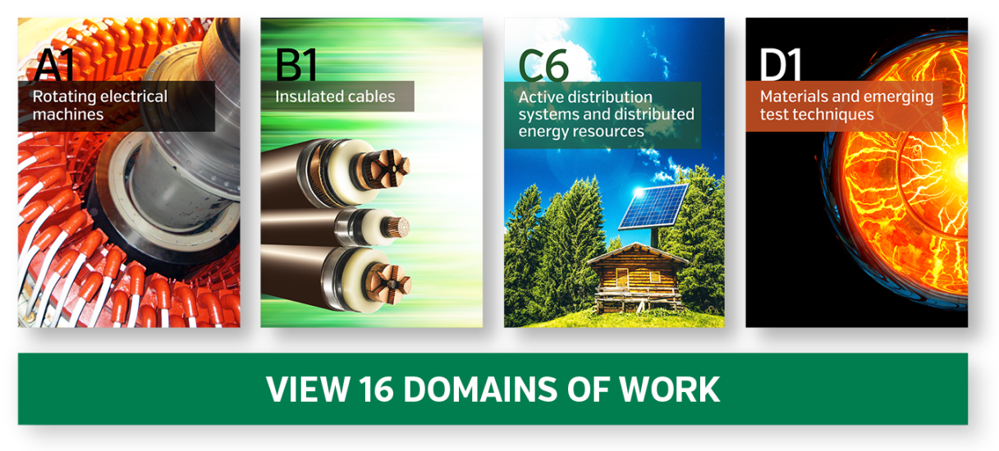

The world’s foremost power system knowledge development programme
Community experts and CIGRE bodies define strategic focus
Focused on key strategic themes based on key challenges, trends and issues
Applied to CIGRE’s 16 domains of work
250+ Working Groups develop the knowledge
Involving 1000’s of power system professionals
Watch a short video on
the programme structure including a summary

Slide 8

CIGRE’s 16 domains of work each has
a dedicated Study Committee
Group A – Equipment:
A1 Rotating electrical machines
A2 Power transformers and reactors
A3 Transmission and distribution
equipment
Group B – Technologies:
B1 Insulated cables
B2 Overhead lines
B3 Substations and electrical
installations
B4 DC systems and power
electronics
B5 Protection and automation
Group C – Systems:
C1 Power system development and
economics
C2 Power system operation and
control
C3 Power system environmental
performance
C4 Power system technical
performance
C5 Electricity markets and
regulation
C6 Active distribution systems and
distributed energy resources
Group D – New materials & IT:
D1 Materials and emerging test
techniques
D2 Information systems and
telecommunication
Watch a short video on
the programme structure including a summary

Slide 9

CIGRE’s four current strategic directions
Future power
systems
Environment and
sustainability
Best use of
existing systems
Unbiased information
for all stakeholders

Slide 10

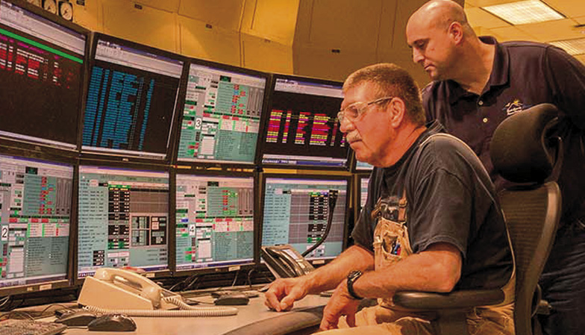
A focus on current pressing challenges:
Renewable energy sources
Growing environmental requirements
Limitations to build new transmission
infrastructures
Architecture of networks and systems
Maintaining the existing power systems
Transmission of large amounts of power
over long distances
Cyber security
Intermittency of renewable power generation

Slide 11
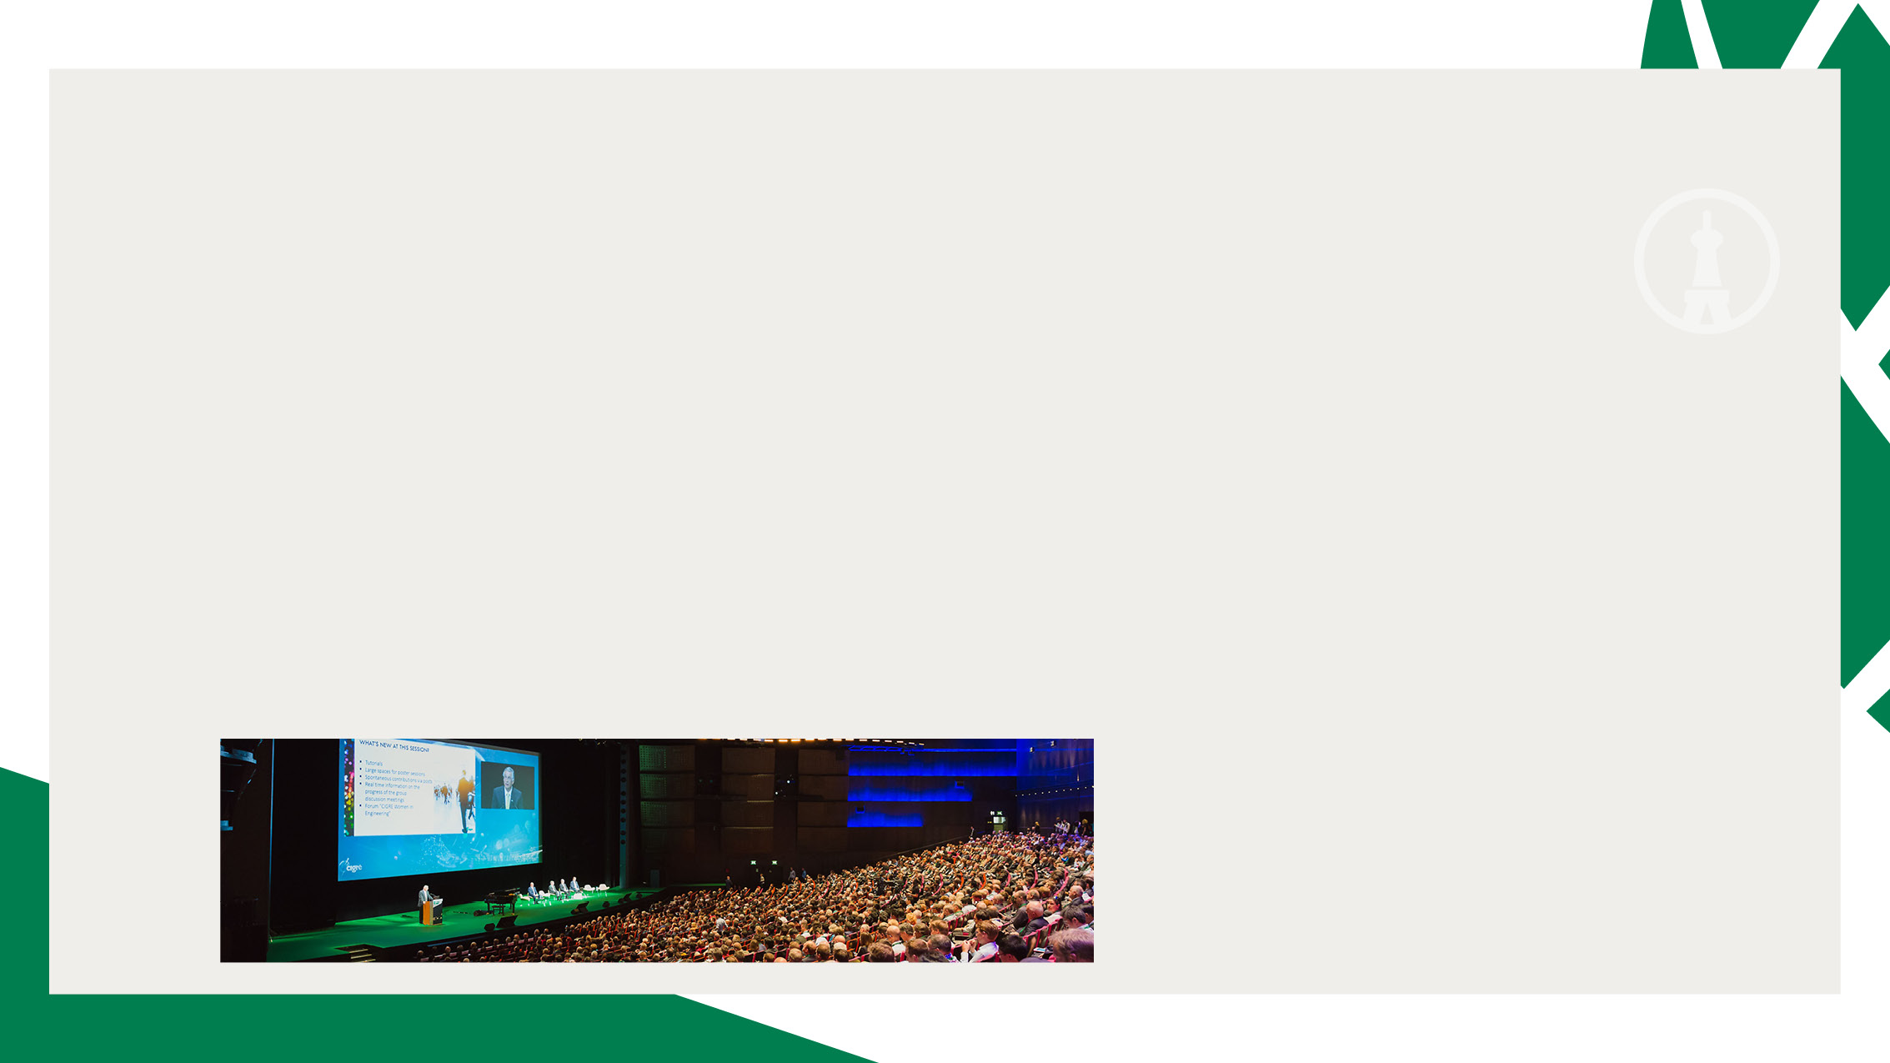

A global collaborative programme
and the Paris Session
A worldwide programme comprising 100’s of high value events run by the
Study Committees (SCs), National Committees (NCs) and other CIGRE groups
Spanning large events such as CIGRE Symposia and Colloquia and numerous
local conferences
Culminating every two years in the Paris Session
The world’s #1 global power system event, unique for its thought leadership
For more on the Paris Session
and CIGRE’s collaborative
programme watch a video

Slide 12

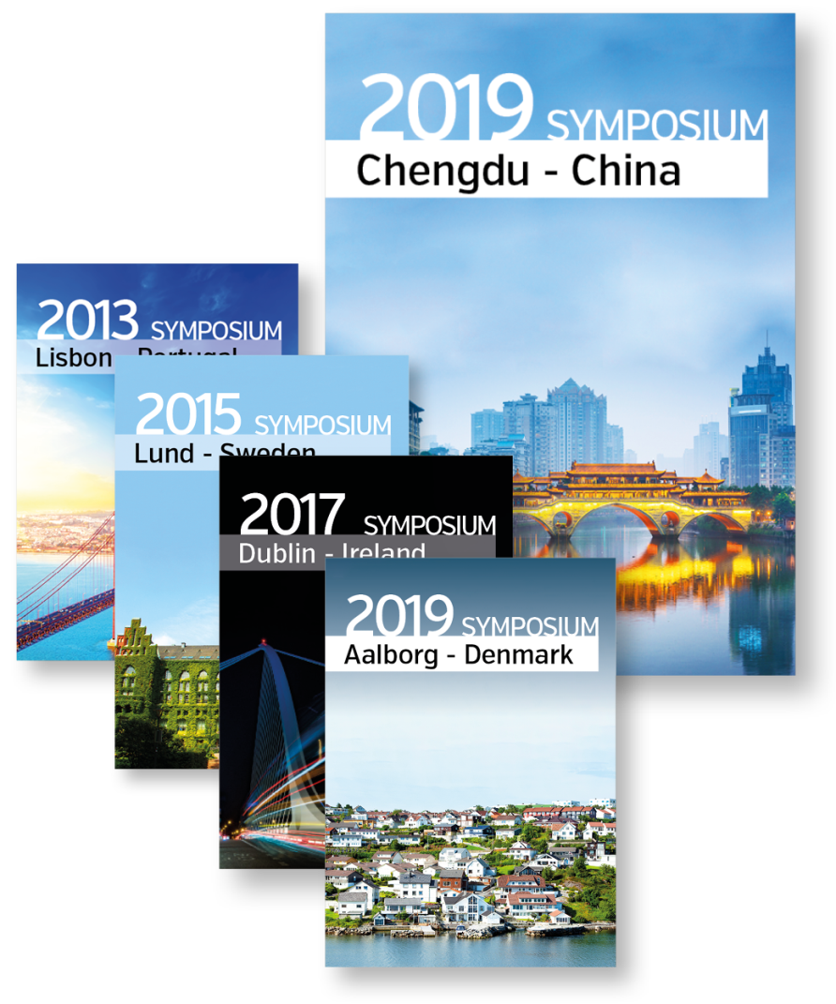
A global collaborative programme
and the Paris Session
The Paris Session at a glance
− 3500+ delegates
− 5000 industry participants
− 94+ countries
− Massive trade exhibit
−160+ working meetings
− 30+ Study Committee sessions
For more on the Paris Session
and CIGRE’s collaborative
programme watch a video

Slide 13



The authoritative source of power system
technical reference information
14000+ technical reference documents and publications
Including 700+ comprehensive Technical Brochures
Based on practical experience and analysed data
Many used in global standards
Includes the famous CIGRE “Green Books”
100’s of technical publications added every year
All available from online library e-cigre.org
For more on CIGRE’s
publications and reference
materials watch a video

Slide 14


Connecting power system people with the
knowledge and solutions they need
A CIGRE membership delivers demonstrable value underpinned by world
leading substance
From individuals through to large organisations the benefits are extensive

Slide 15
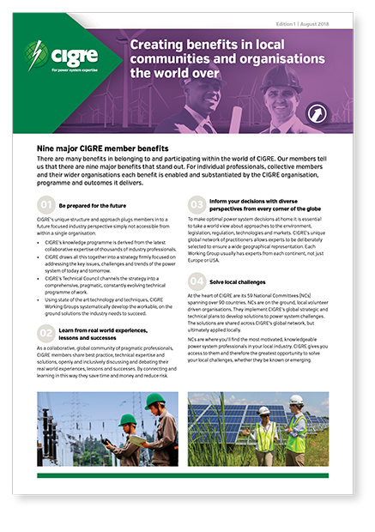
Nine ways CIGRE membership delivers value
1. Be prepared future key trends, innovations and challenges
2. Learn from real world experiences, lessons and successes
3. Inform your decisions with diverse global perspectives
4. Collaborate with your local CIGRE organisation (NC) to address local challenges
5. Source the most authoritative reference information
6. Get unbiased, vendor neutral, fact-based, technical solutions
7. Gain access, at a nominal cost, to world leading experts
8. Grow your individual and organisational skills
9. Connect with your industry in a technically-based setting
For more on CIGRE’s
Benefits ask for our
Info leaflet

